Slide 1
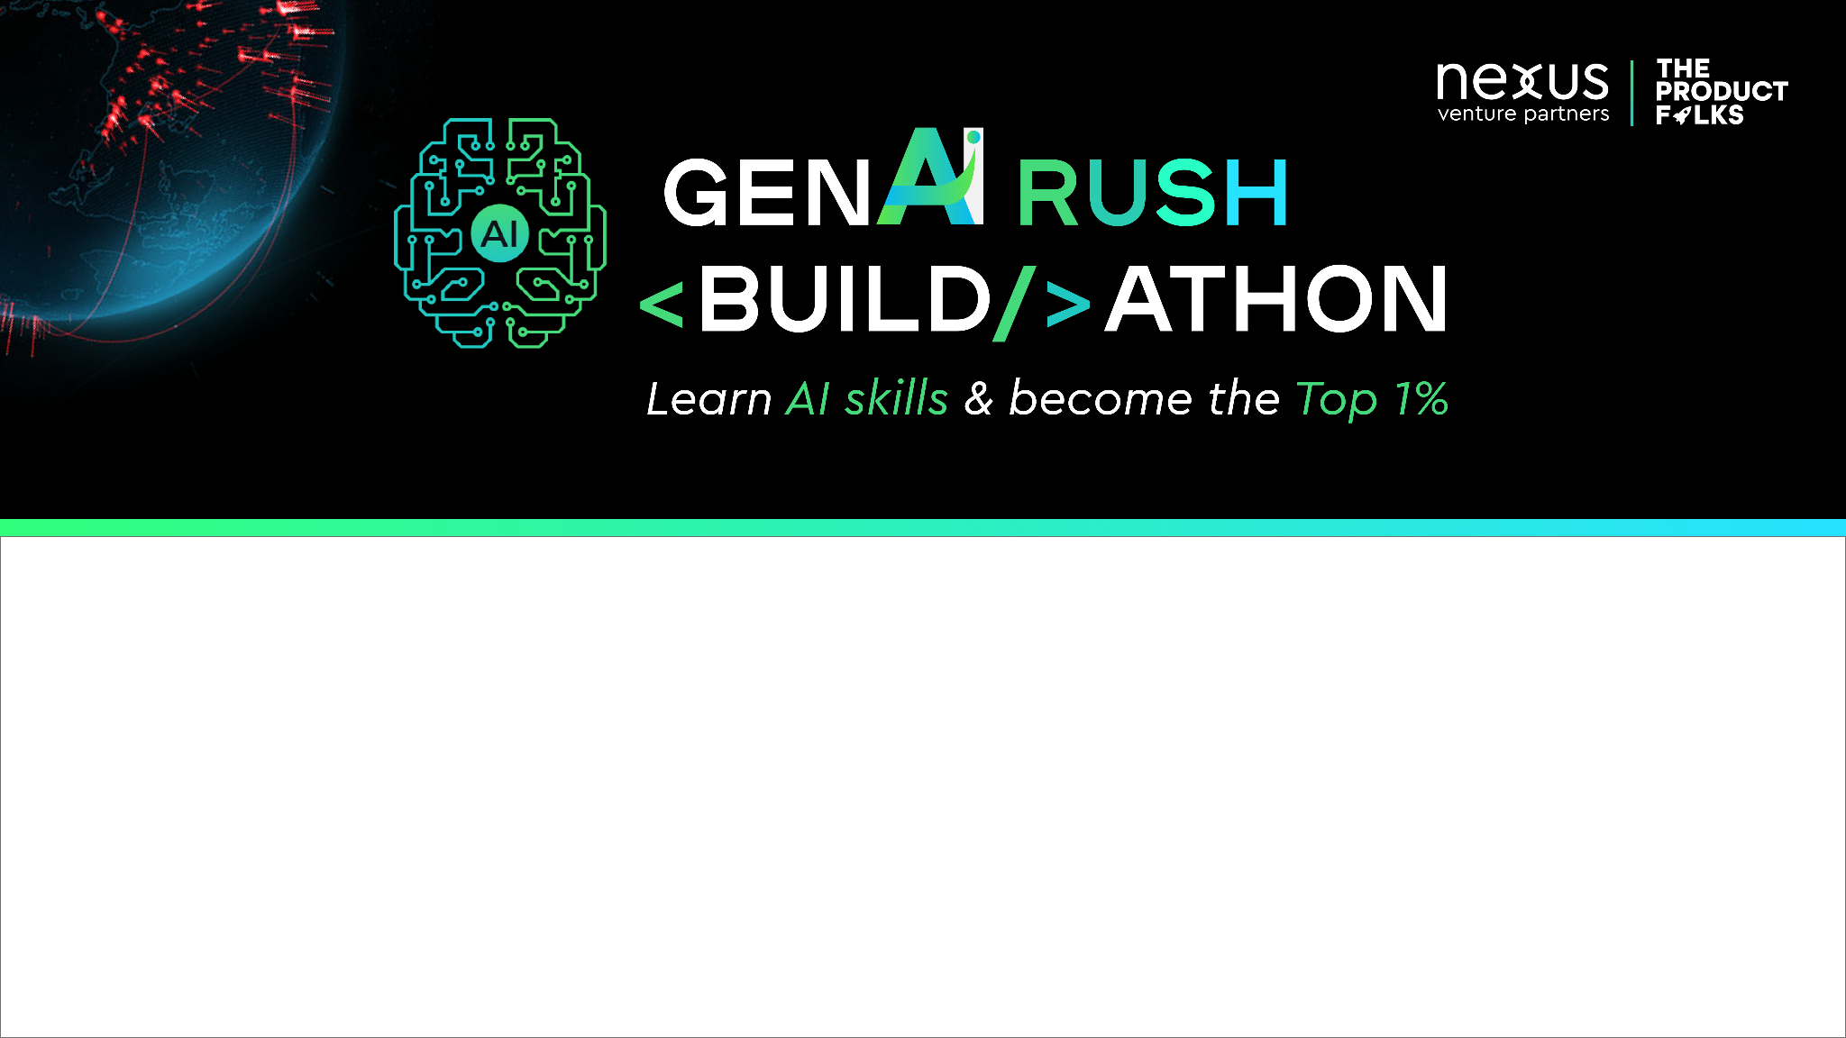

Team Name : Creative Crew
Problem Statement : AI for Mental Health support

Slide 2

Brief about the Idea:
Develop an AI-powered chatbot or virtual assistant that provides mental health support and counselling. It should be capable of understanding and empathizing with users, offering guidance, and referring them to professional help if needed.
The prevalence of mental health issues is increasing at an alarming rate. To address this pressing issue, this project proposes the development of an AI-powered Mental Health Support system.

Slide 3
Brief about the Idea:
The AI for Mental Health Support system aims to leverage the capabilities of AI and natural language processing to provide accessible, personalized, and confidential mental health assistance to individuals in need.
The system will be designed to interact with users through various channels, such as web-based platforms and mobile applications, allowing users to seek support conveniently from the comfort of their own homes.

Slide 4
Opportunity :
User Interaction - The User provides input in the form of text or voice, expressing their feelings, concerns, or thoughts related to their mental health.
Input Analysis - The AI system analyzes the user input, utilizing natural language processing (NLP) techniques to understand the emotional state, detect signs of distress, and identify potential mental health conditions.
Personalized Support - To provide personalized support to individuals based on their unique emotional analysis
Conversational Interaction - The system goes beyond simple information provision and aims to establish a therapeutic interaction that mimics human conversation.
Crisis Intervention - The AI system is equipped with protocols to identify users in immediate crisis or at risk of self-harm and guides the user with human health professionals if necessary.
Collaboration and Ethical Considerations - The project emphasizes the collaboration between mental health professionals, AI experts, and data scientists and ensuring that individuals can trust the system with their personal information.

Slide 5
List of features offered by the solution :
24/7 Availability
Emotion Recognition
Mood Tracking and Analysis
Personalized Recommendations
Multi-lingual Support
Resource Sharing
Integration with Mental Health Professionals
User Engagement and Retention

Slide 6
Process Flow Diagram/Use case Diagram:
User Interaction
Input Analysis
Personalized Support
Conversational Interaction
User Feedback and Iterative Improvement
Crisis Intervention
Continuous Learning

Slide 7
Business Logic of the solution :
Emotional Analysis
Resource Recommendation
Cost-Effectiveness
Accessible and Inclusive
Early Detection and Intervention

Slide 8
Technology used :
Natural Language Processing (NLP) - to analyse and understand user input,
Machine Learning (ML) - to train models that can perform tasks like emotional analysis, personalized support, and crisis detection.
Conversational AI - enable the system to engage in human-like conversations with users.
Data Storage and Processing - to store user profiles, conversation histories, and other relevant data securely.
Integration with External Resources - to integrate the system with external mental health resources,
Cloud Computing - to deploy and scale the AI system, ensuring availability and performance.
Security and Privacy Measures - encryption, access controls, and secure communication protocols
User Interfaces - Web-based platforms, mobile applications, or chatbot interfaces

Slide 9
Estimated cost of/after implementing the solution :
The cost estimation for an AI-based mental health support system can vary significantly depending on several factors like,
Data Collection and Annotation, Machine Learning and AI Models, Compliance and Security, etc..,
And the Approx. cost is estimated to be 1,00,000

Slide 10


